Slide 1

Predicting Attendance for the 2018-2019 Season
By Linus Jen

Slide 2
Goal
01
Relationships
03
Modeling
04
Limits to the Model
05
Create a model to better predict attendance
Data Mining
02
Find revelant data that may improve a model
How do the different variables relate to one another?
Understand and apply regression statistics
Assumptions made for our models
Limitations to its application

Slide 3
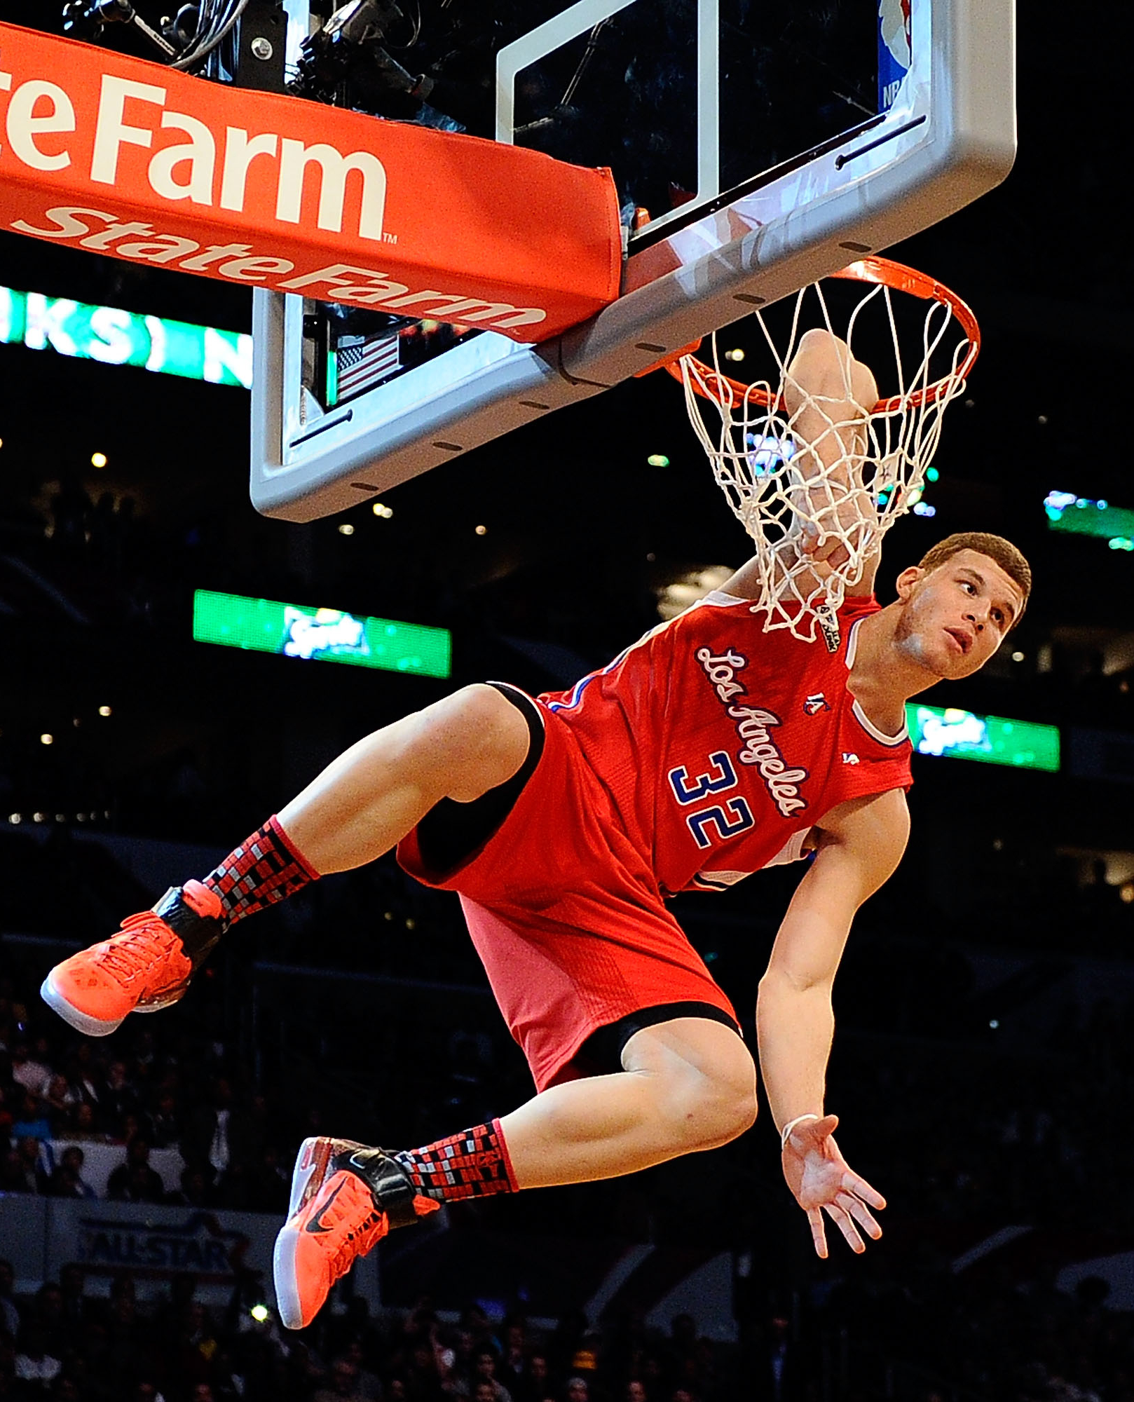
The Allure of Basketball Competitions
Why the NBA?
Grew up playing basketball
Entertainment of highlight reels
Follow the success of college players
Why the Clippers?
Grew up fans of the franchise
Came to watch the other team play
Fans of the players

Slide 4
Finding the Relevant Data
While the data given covers variables such as Vegas Odds and number of championship won, it lacks the granular information such as:
How popular is a team and its players?
How good are the players for the upcoming year?
Are games close to holidays?
Web-scraping allows us to easily gather these values from trustworthy sources

Slide 5
Heat Check
How popular are their opponents?
All-Stars
Jersey Sales
Instagram Followers
Fans make up 50% of votes to determine what players make the All-Star game. Using the prior year’s All-Star roster, we can determine how many All-Star players are on each team.
Every year, the NBA store releases the most popular jerseys for the year. Given how jerseys are not cheap themselves, those who would pay a pretty penny to rep their team’s swag wouldn’t be afraid to drop some more to watch their favorite teams live.
Instagram and other social media sites are easy ways to gauge how popular a team is. This might also provide insight as to which teams are expected to be the most hype, as fans may want to track the progress of specific teams.

Slide 6

Holiday Blues
Can dates play a role in attendance levels?
Do games during the week have less attendance than games over the weekend?
01
Could there be a correlation between proximity to a holiday and attendance?
02

Slide 7
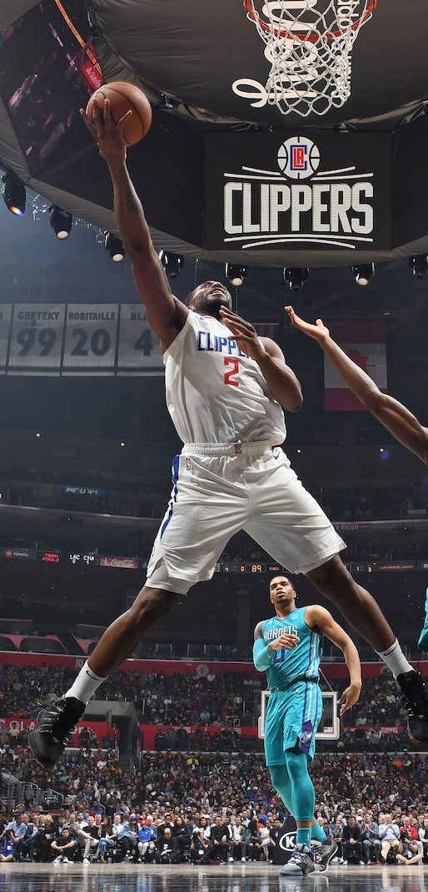
Variable Selection
Variables were chosen by graphing, checking interactions, and running diagnostic plots and checking their respective ANOVA values

Slide 8
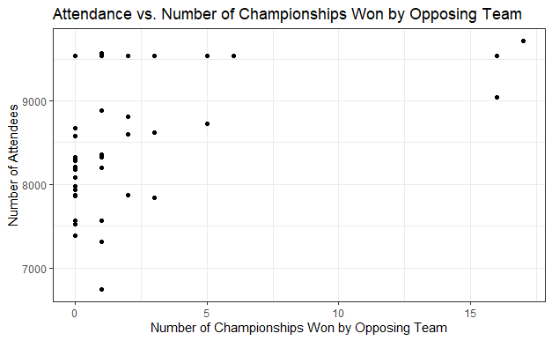
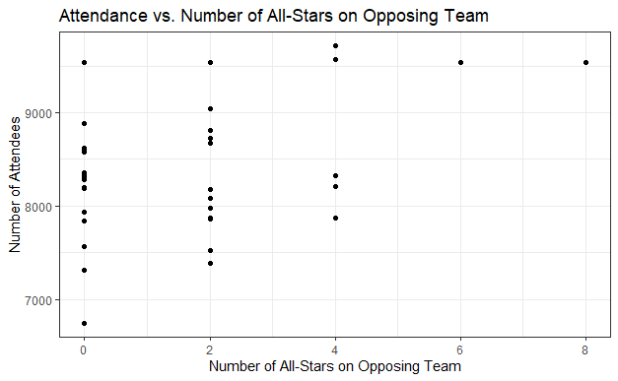
Graphing Variable Chosen
Number of All-Stars on the opposing team
There seems to be a positive relationship between attendance and number of All-Stars
There seems to be a positive relationship between attendance and championships won by the opponent
Championships Won by the opposing team

Slide 9
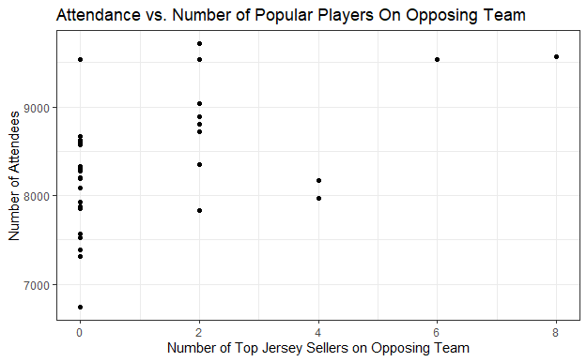
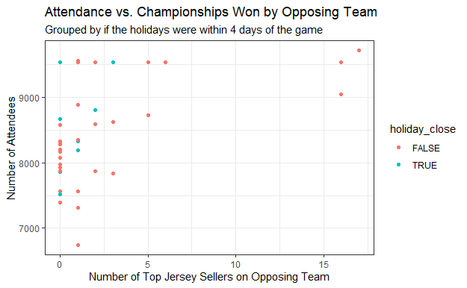
Graphing Variable Chosen
Interaction between Championship and Proximity to a Holiday
Again, another positive relationship between these two variables
Popular Players on the opposing team, as defined by jersey sales

Slide 10
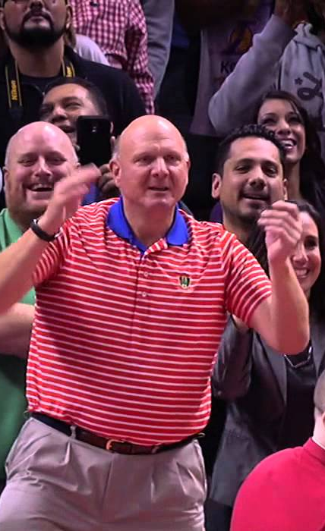
Modeling and Findings
(Finally, the fun stuff!)

Slide 11
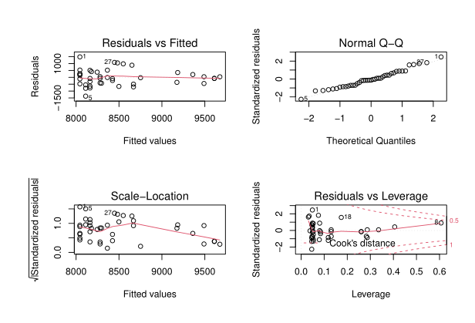
Final Model
The diagnostic plots, shown below, show that the assumptions of constant variance and the errors following a normal distribution hold true.
Our final model is as follows:
Prediction = 8044.39 + 58.84(# of All-Stars) + 67.17(# of championships won when holidays are not close) + 126.61(number of All-Star players from the last All-Star Game) + 312.56(# of championships won when the holidays are close)
Using 2017’s model, which had an R-squared value of around .37, we got a root mean squared error of 893.53, versus the root mean squared error of 974.09 when using the mean attendance of the 2017-2018 season. This isn’t bad, for an improvement of 10%.
This simpler model was used to better explain the findings. Both the linear regression and ANOVA tables showed that the variables significantly improved the predictions.

Slide 12
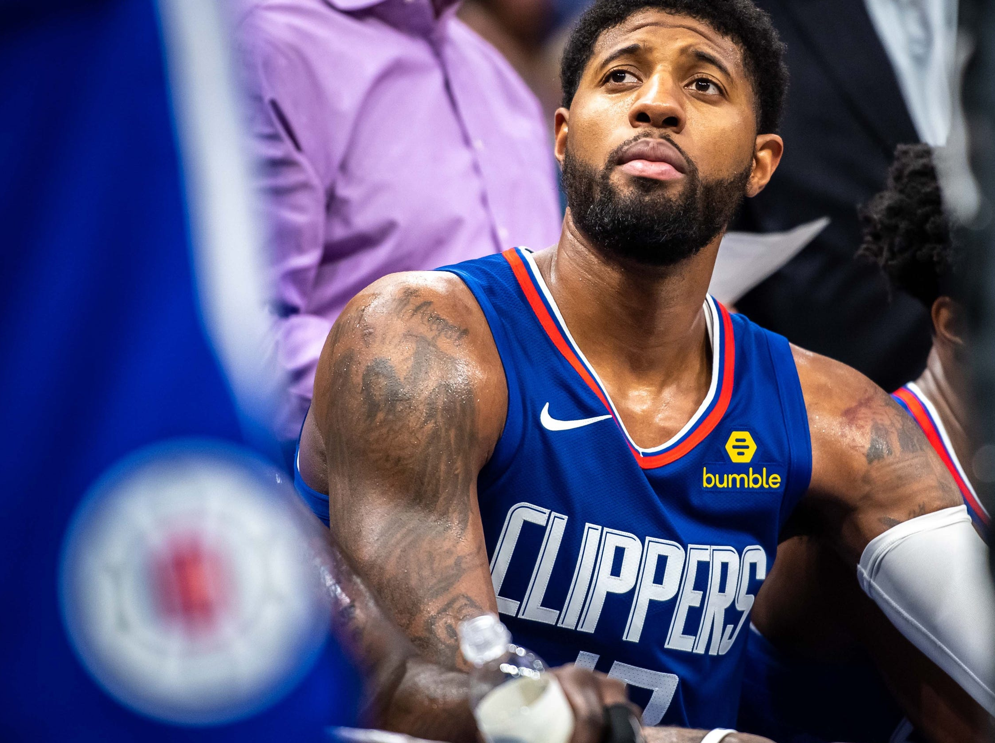
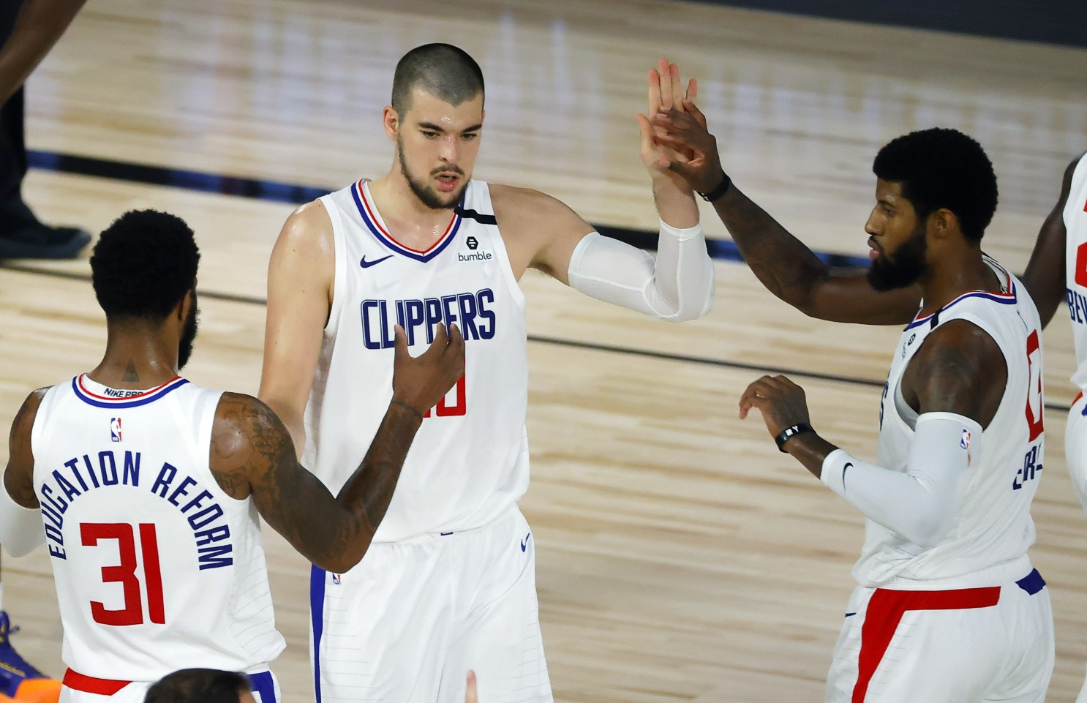
Limitations
Many of the variables not included in this list were found to not be significant, and thus were not included in the final portion of this presentation. They are briefly discussed in the respective PDF file.
The dataset provided did not match the attendance records found on NBA.com, and while the values were heavily correlated, these inaccuracies may limit our prediction abilities
Future Steps
Due to time constraints, I was unable to web-scrape all the data desired. I was hoping to see if the number of games on the same day as Clippers game had an impact on attendance levels
In addition to this, several papers and articles mentioned the use of random forest model to improve prediction. For future actions, I would attempt these models to compare its benefits.
Lastly, more incorporation of time series analysis would be helpful to discover monthly or seasonal trends

Slide 13
Sources
https://www.basketball-reference.com
https://www.NBA.com
https://www.calendarpedia.com/holidays/federal-holidays-2013.html
Data provided by the Clippers Organization

Slide 14

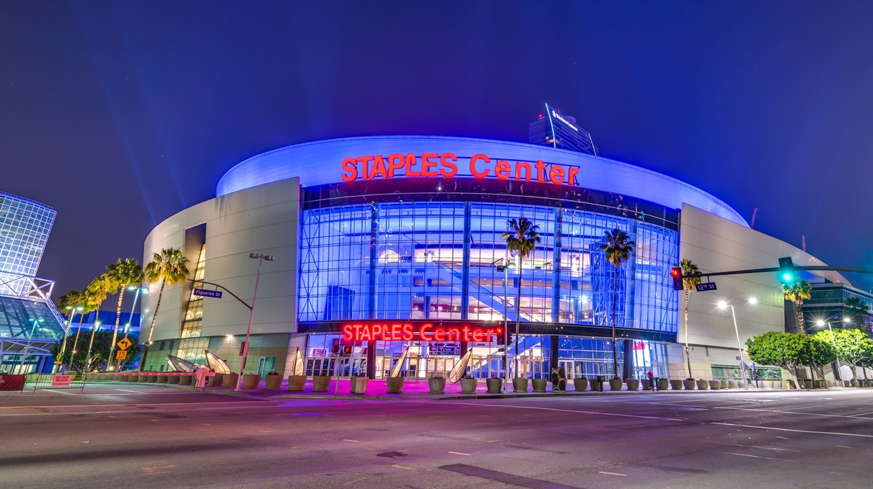
Thank you!

